Slide 1
Installing Development Environment

Slide 2
Installing Python Development Environment
Python Development Kit
Eclipse
PyDev plug-in for Eclipse

Slide 3
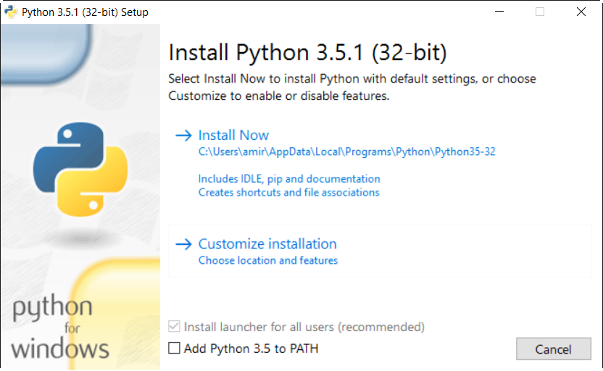
Python Development Kit
Download the latest Python Development kit from this following link:
https://www.python.org/downloads/
Install Python by openning the instaler package (e.g. python-3.5.1.exe)

Slide 4
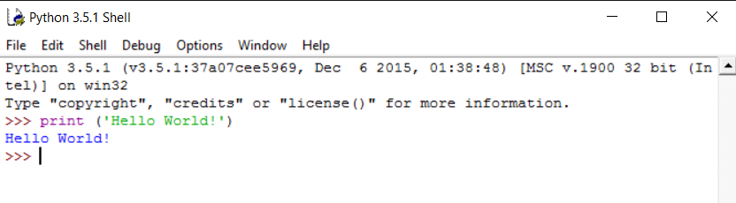
Python IDLE Interactive Shell
After completing the installation, open IDLE (python interactive shell) from the start menu
Type in print(‘Hello Word!)

Slide 5
Installing Eclipse
We will use Eclipse for Python IDE
Install Eclipse from the following link
https://www.eclipse.org/downloads/eclipse-packages/
Install Eclipse IDE for C/C++ Developers

Slide 6
Install PyDev
PyDev is an Eclipse IDE plugin for Python development
Follow instruction to install PyDev plugin
Open Eclipse and select the default workspace

Slide 7
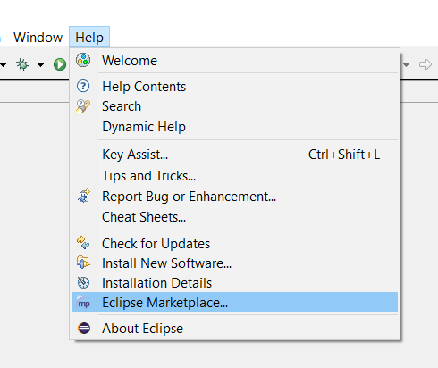
Install PyDev
Go to Help - > Eclipse Marketplace

Slide 8
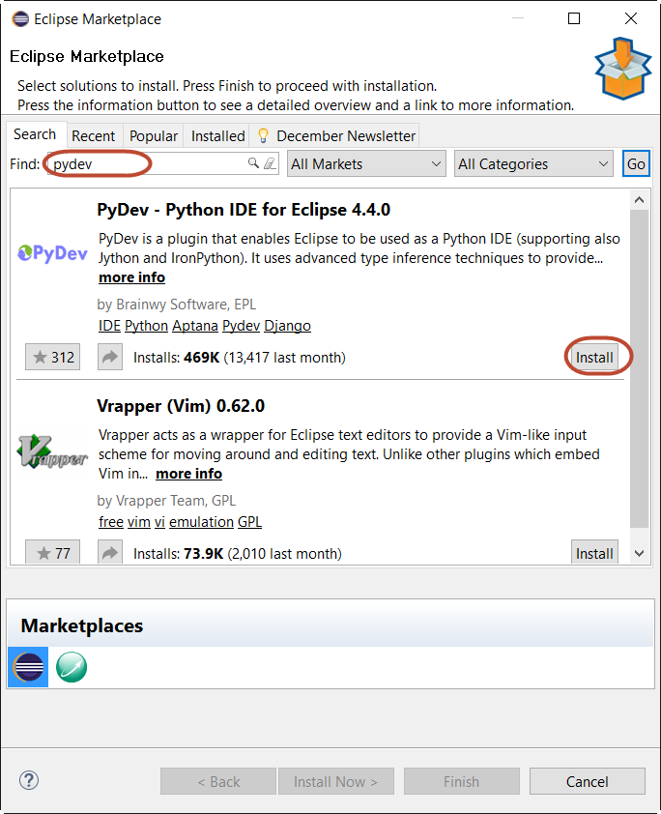
Install PyDev
Search and install PyDev plugin

Slide 9
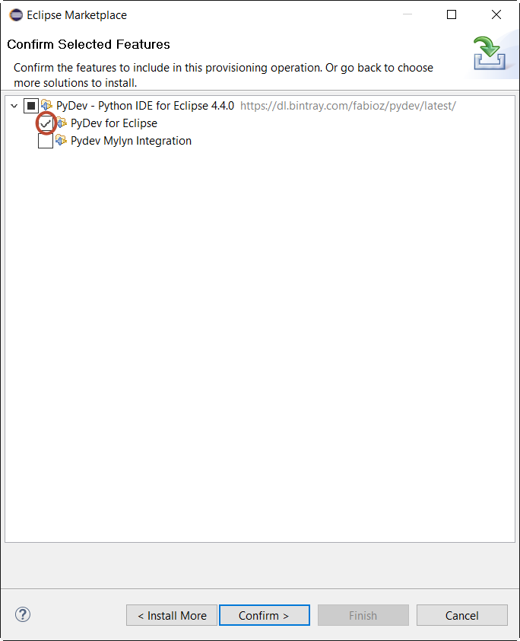
Install PyDev
Check box “PyDev for Eclipse”

Slide 10
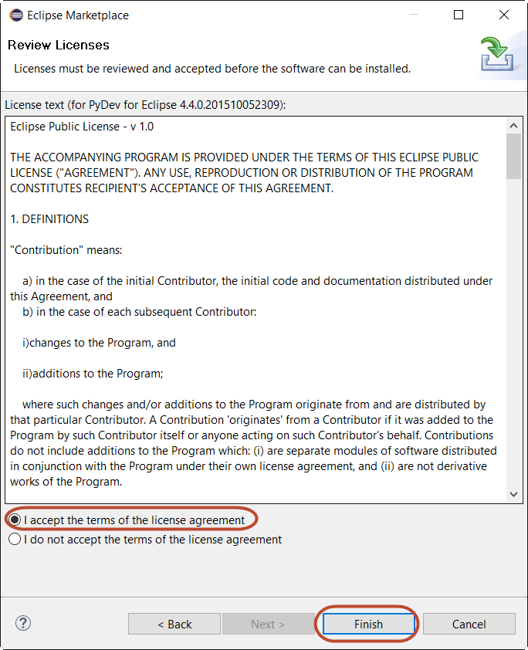
Install PyDev
Accept the license agreement and Finish

